Slide 1
Exam Management System - PROPOSAL Roi Tiefenbrunn, Ofek Nov, Mor Abu, Idan Aharoni
Software Engineering
Faculty of Engineering
Ben Gurion University of the Negev

Slide 2
Exam Management System
Exam Management System
מערכת ניהול מבחנים
Student Name | ID | Email | Phone | Signature
Roi Tiefenbrunn | 209829340 | roitief@post.bgu.ac.il | 054-7168459
Ofek Nov | 206618175 | Ofeknov@gmail.com | 052-738-0233
Mor Abo | 209239797 | Morabou1@gmail.com | 050-334-5338
Idan Aharoni | 206430050 | idan.aharoni2@gmail.com | 054-973-7462

Slide 3
Customer
Customer Name – Dr. Mayer Goldberg
Customer Representative Person – Dr. Mayer Goldberg
Role – Lecturer, Head of Teaching Committee
Email – gmayer@little-lisper.org
Phone Number - 055-660-3392

Slide 4
Project’s Motivation and Purpose
General Problem:
With the increase in the size of the student body, it has become difficult to manage grading within the given time constraints. This has led many courses to adopt a multiple-choice format, which is faster to grade, and easier to analyze.
The creation of challenging multiple-choice tests in the sciences is a non-trivial task.
The creation of one-time-use questions is costly and unsustainable.
Specific Problem:
Maintenance of a large and growing pool of questions is proving to be difficult.
Current implemented system is local, inaccessible and hard to learn.
Division of labor between TAs and test examiners is done by hand and is hard to track.
The possibility of tracking quality of questions & answers is crucially needed.
What is the solution?
A web-based System for managing work, subjects, questions.
Intended to replace current offline system.

Slide 5
What already exists?
The client, Mayer Goldberg, has developed a theory of meta-questions and their translation into multiple-choice questions.
A scheme-based system was created to synthesize & generate multiple-choice and implement said theory.
The existing system has now been in use for 6-7 years in a large number of courses.
Current system’s low accessibility is too hard for people without deep knowledge and understanding to use comfortably.

Slide 6
Customer’s Vision
Workflow Management System:
Support various roles (for TAs, graders, instructors, etc).
Manual+Algorithmical generation of tasks based on priority and needs.
Manual+Algorithmical spread of tasks throughout configured workforce.
Tracking over work velocity and output (= blame feature).
UI:
Web-based system.
Dashboard based on Role.
Content creation:
Manage content by subjects/keywords/classes.
Creation and management of stems, meta-questions, questions, appendices.
Creation and management of possible solutions/distractors per question.
Output creation:
Flexible LaTeX-based creation of exams/keys/solutions.
System:
Have both WMS and content handled in DB.
Version control of questions, handled in DB.
Easy install, migration, backup and cloning of the system.

Slide 7
Project Description
Frontend+Backend - developed in JavaScript as it is widely user, stable, with frameworks that allow easy implementation of features.
Simple, intuitive and smooth interface - better UX is key for adoption by new users.
PostgreSQL based DB – stable and strong relational DB.
Features – Detailed in org file.

Slide 8
User Interface
Role based workflow management interface:
View and filter content by subjects/keywords/classes.
Creation and management of stems, meta-questions, questions, appendices.
Creation and management of possible solutions/distractors per question.
Create new Exam

Slide 9
Project’s Risk Assessment
Challenge | How to overcome? (Bonus)
Security and confidentiality management | Working on a private network (VPN environment may be established)
Working with new languages such as JS, LaTeX | Introductory online courses, working with established APIs.
Time management | Working with task boards such as Jira/Github with weekly meetings.

Slide 10
Project’s Environments and Languages
The Project UI and BE will be developed in JavaScript
System state and information will be managed in PostgreSQL – an SQL based DB
Document generation will be done in LaTeX

Slide 11
Evaluation and Testing Plan
Accessibility Testing
Unit Testing
Sanity Testing
Acceptance Testing
End to End Testing
Security Testing

Slide 12
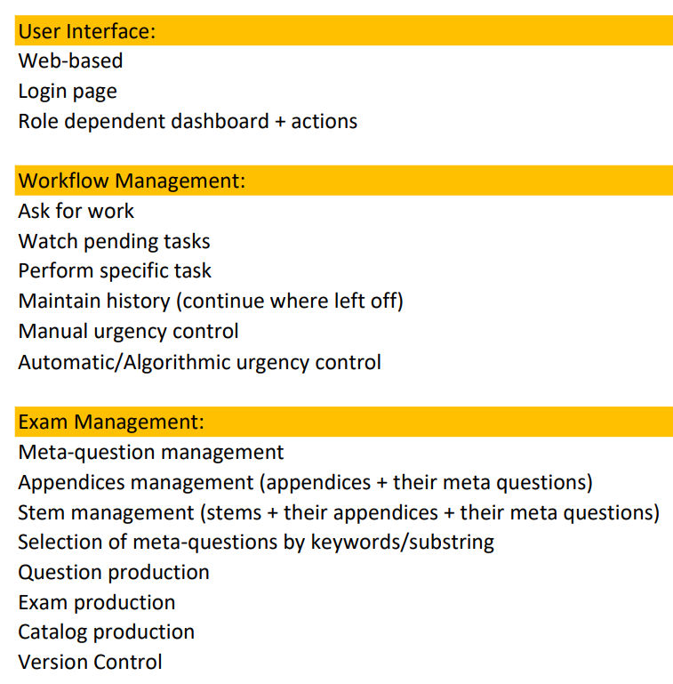
Project’s Steps and Timeline
Semester A
1 month
User interface (shell)
2 month
Workflow management
2 month
Testing
Semester B
3 month
Workflow management
2 month
E2E Testing

